Slide 1


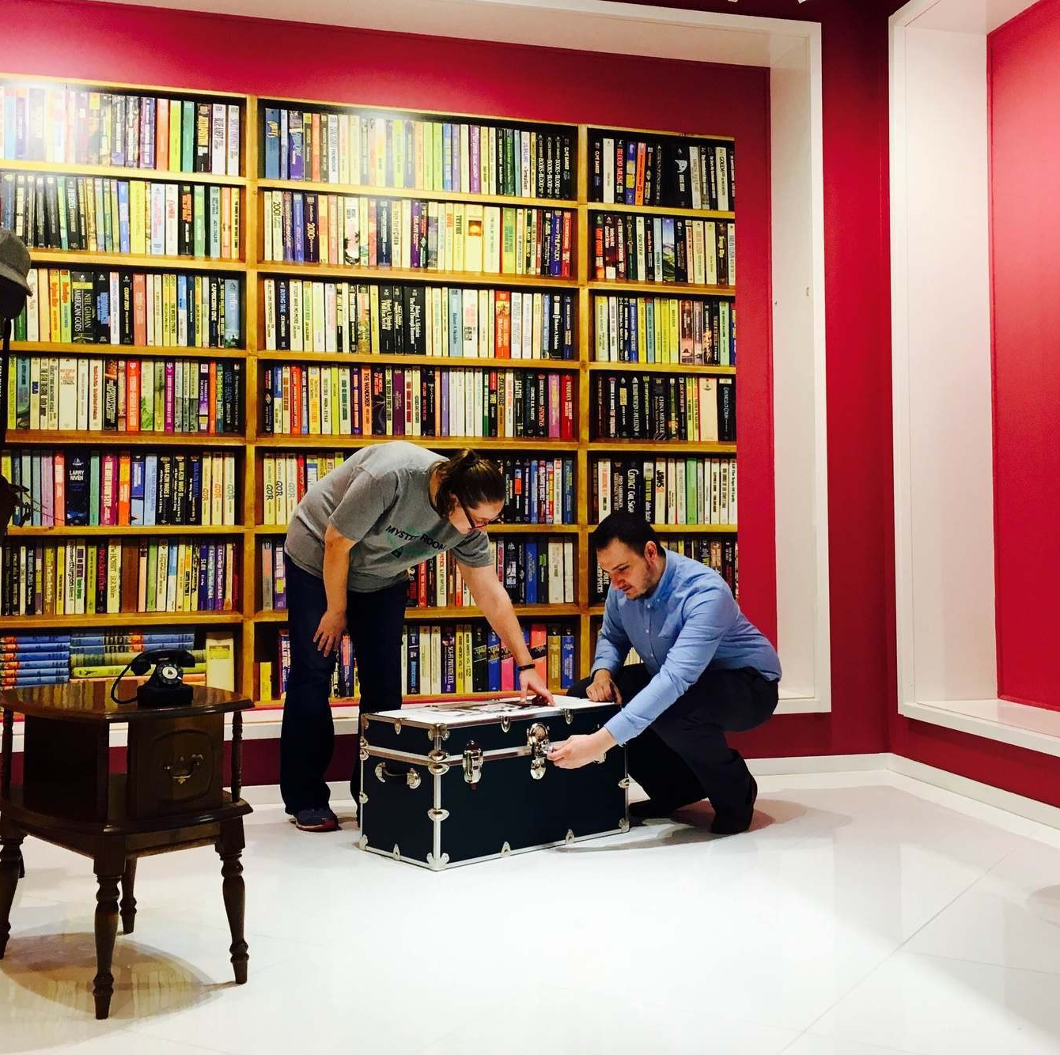

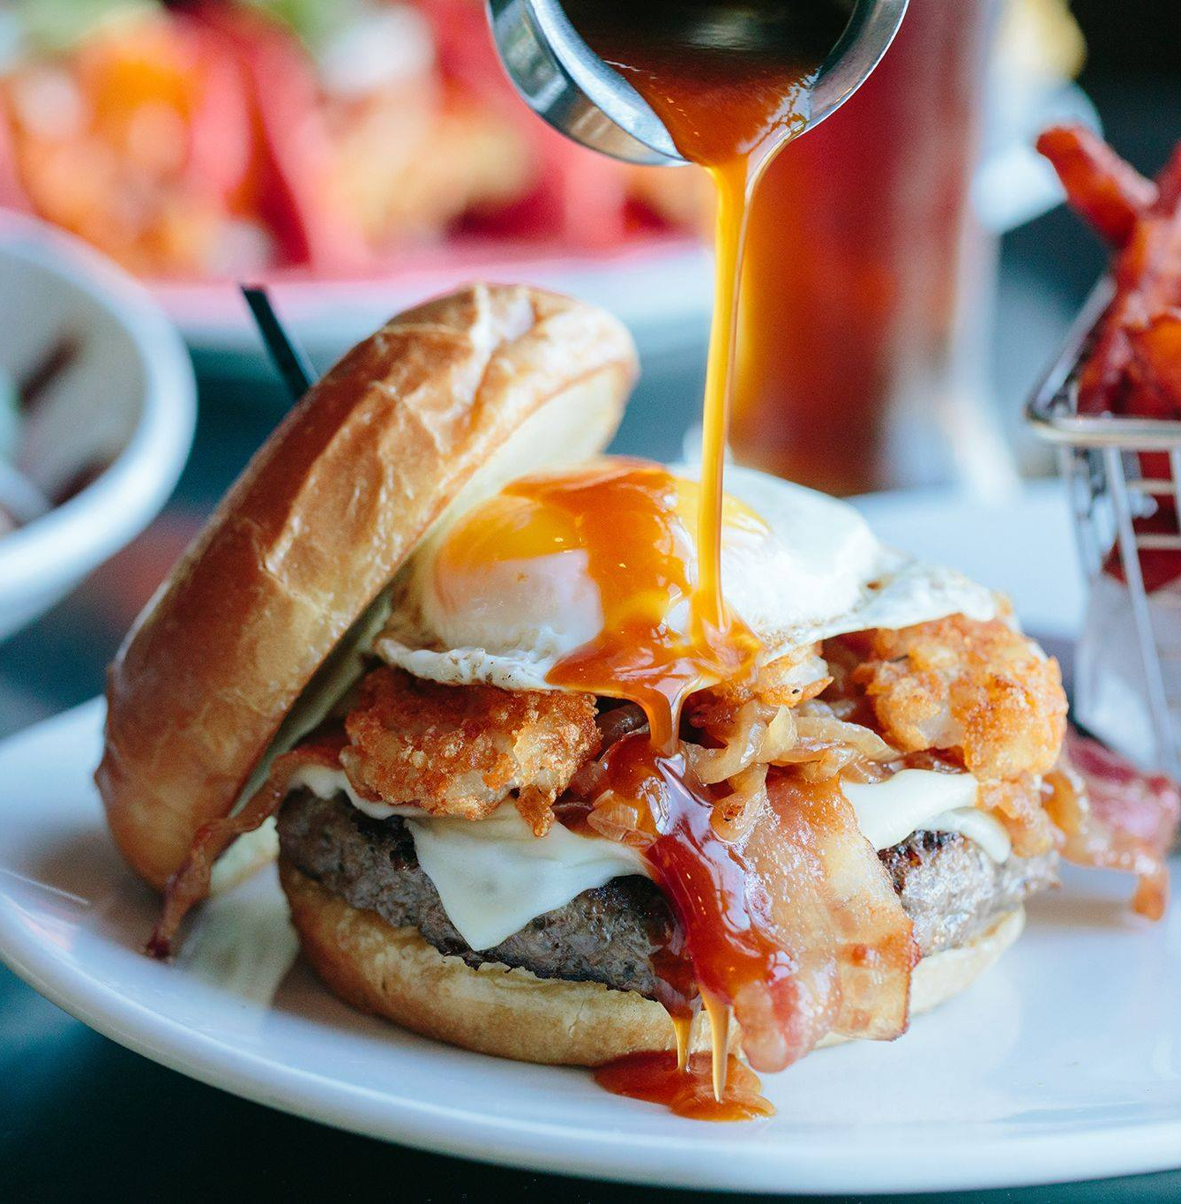
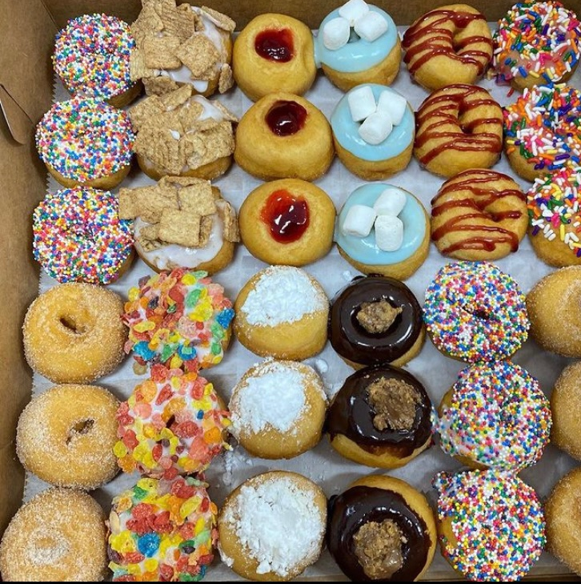
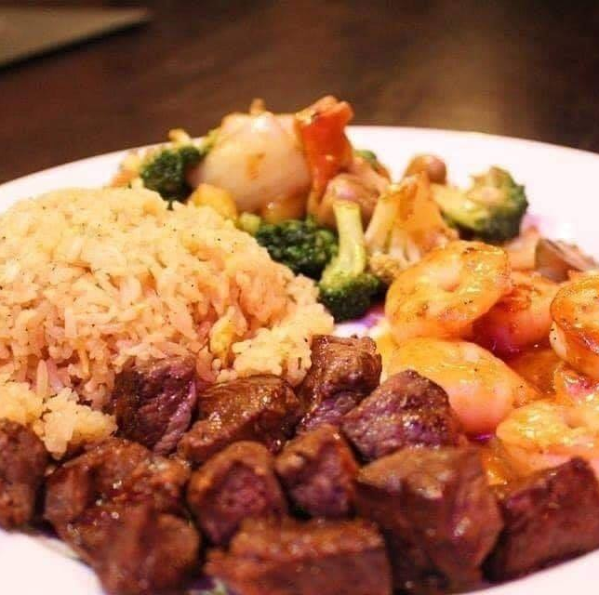


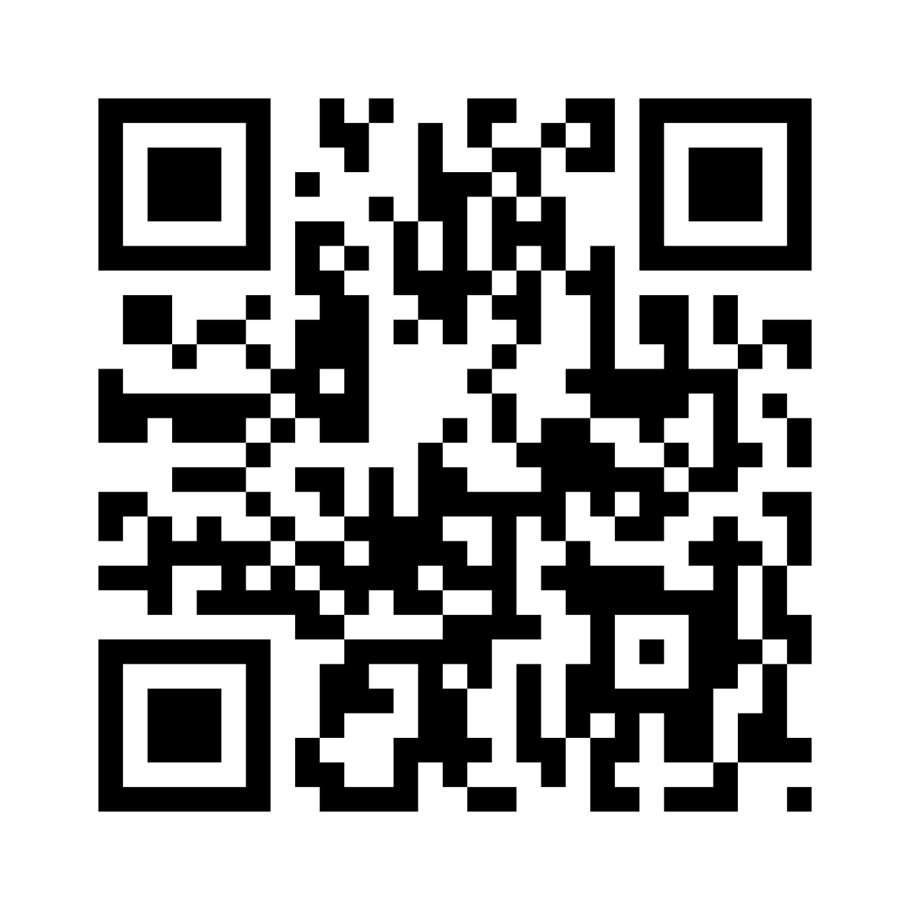



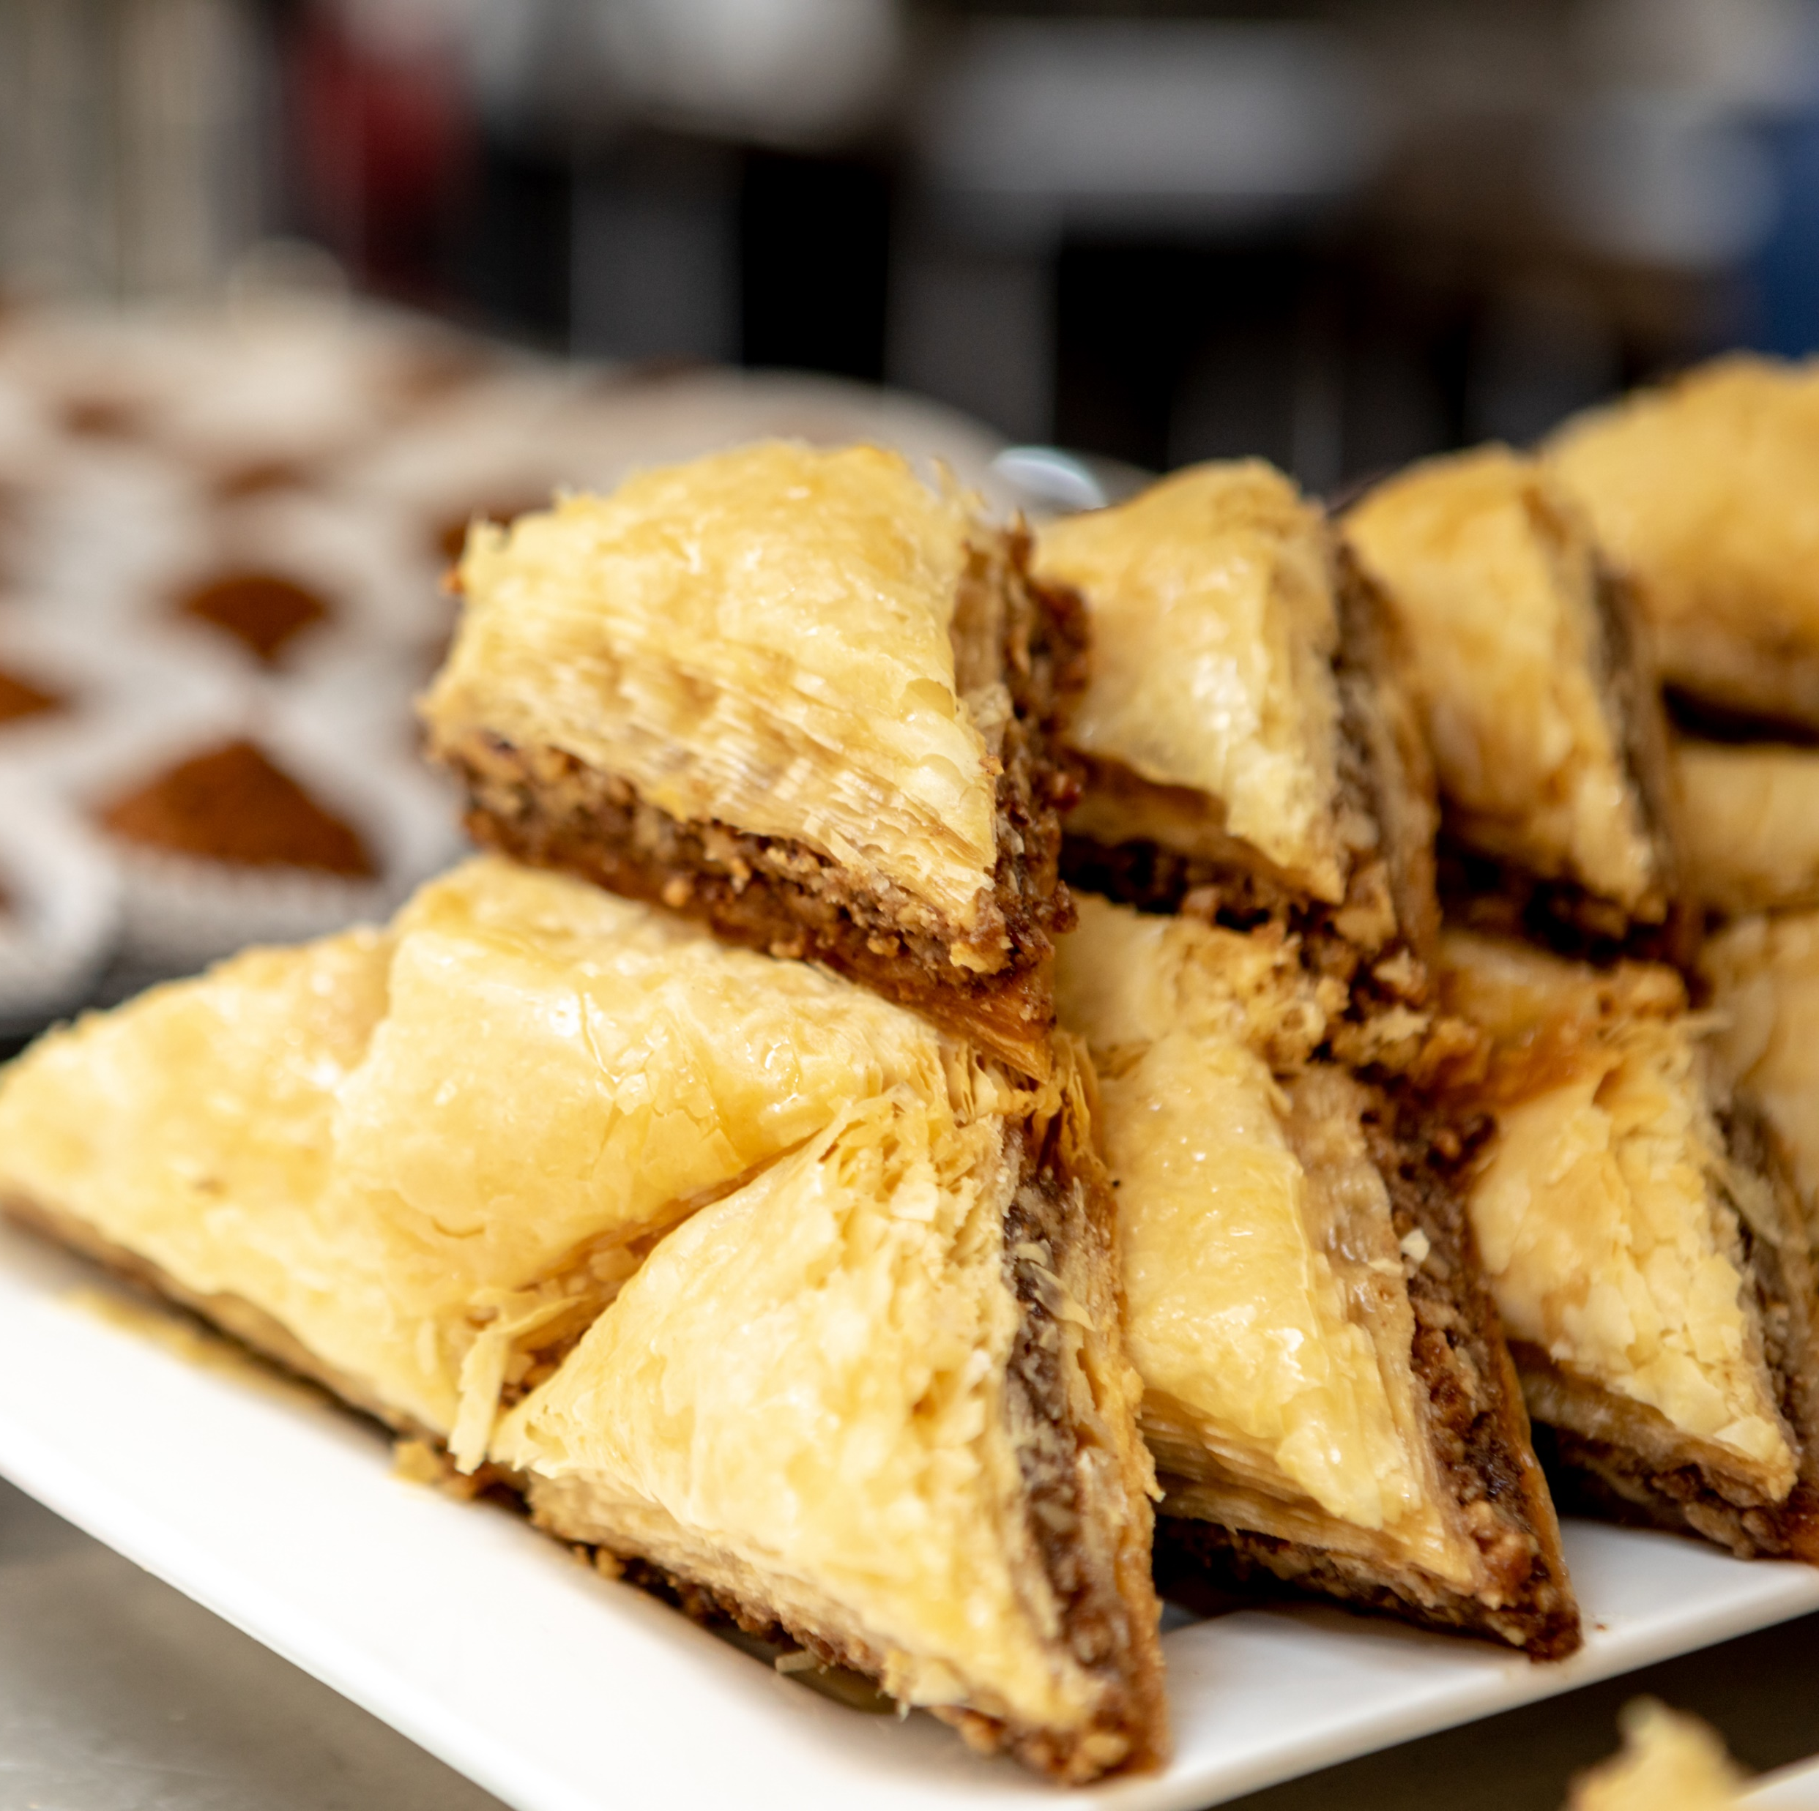



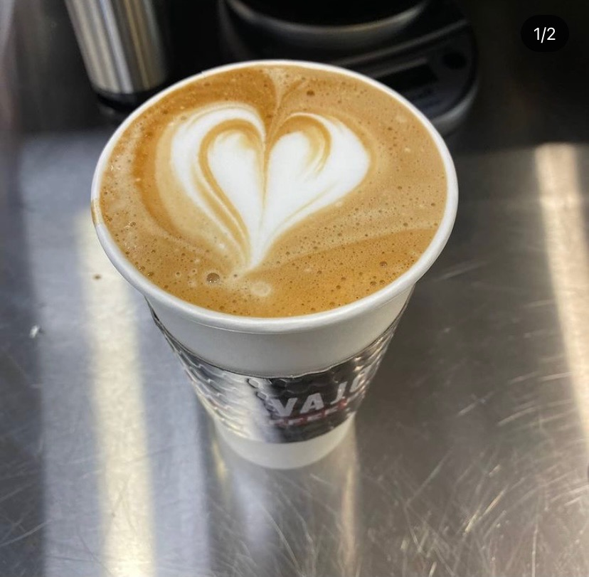





Scan to
*
*No purchase necessary. One random grand prize winner will be selected from all eligible entries received across Pyramid shopping centers on or before June 30, 2021. Must be 18 or older to be eligible. Visit www.galleriacrystalrun.com for full details. The sweepstakes is subject to all applicable laws and regulations and is void where prohibited by law. All rights reserved./

