Slide 1
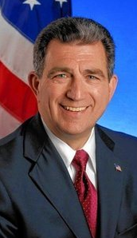



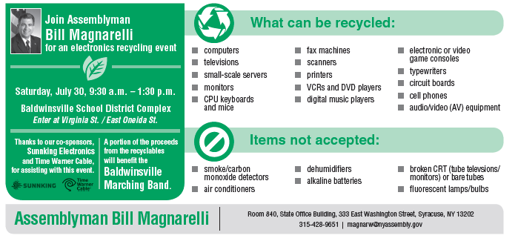
Assemblyman Bill Magnarelli
Sponsors
Electronics
Recycling Event
Free!
Saturday, November 19
9:30 a.m.- 1:30 p.m.
Destiny USA
Pink Parking Lots – near pedestrian bridge
Proceeds benefit the Butternut Community Police Center

